Slide 1
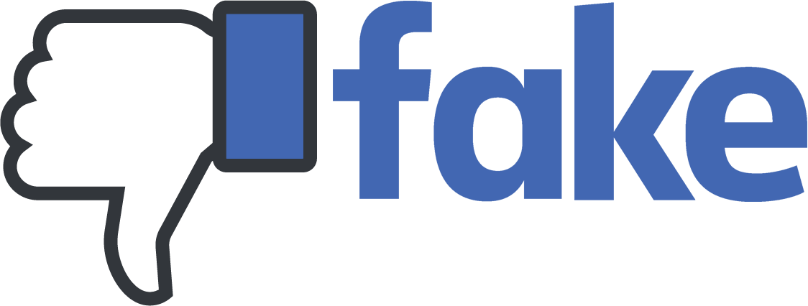

MEDIA & THE PUBLIC
Week 7 Misinformation & Fact-checking
Ryan Wang
ryanyang@psu.edu

Slide 2
How good are we dealing with misinformation?
Notes:
https://create.kahoot.it/share/misinformation-test/584e3b7e-ac95-4503-ad76-845bf246a8f2
Q7: https://www.tiktok.com/@restroomuser/video/7013507743411637509?is_from_webapp=1&sender_device=pc&web_id6893390271377245701

Slide 3
Information disorder
Misinformation: Information that is false, but not created with the intention of causing harm.
Disinformation: Information that is false and deliberately created to harm a person, social group, organization or country.
Mal-information: Information that is based on reality, used to inflict harm on a person, organization or country.
Source: Council of Europe report (2017, p. 20)
“Fake news”: purposefully crafted, sensational, emotionally charged, misleading or totally fabricated information that mimics the form of mainstream news (Zimdars & McLeod, 2020)

Slide 4
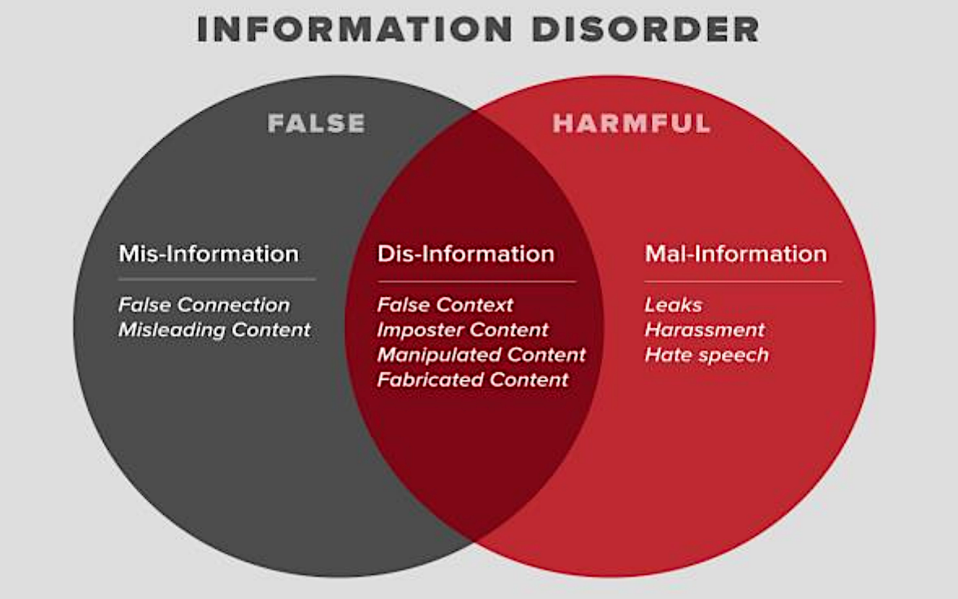
Information disorder
Source: Council of Europe report (2017)

Slide 5
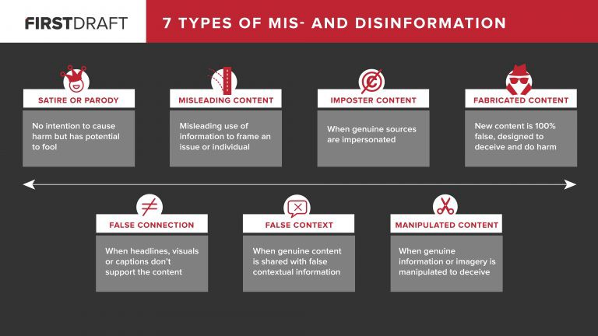
Typology of “inaccurate information” (Wardle, 2017)

Slide 6
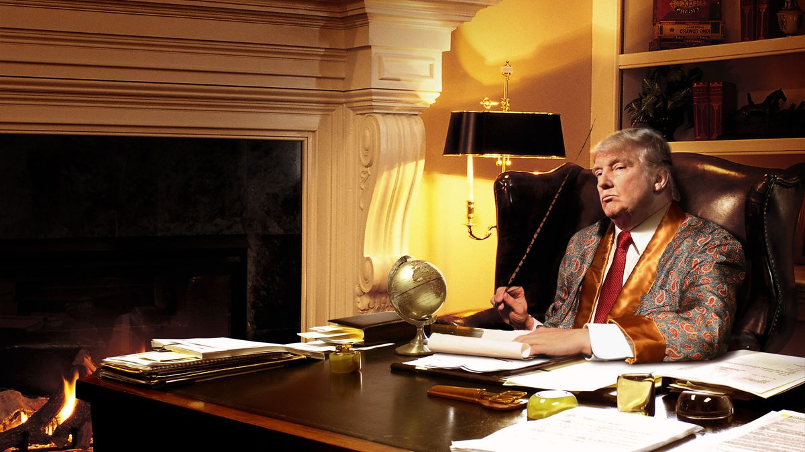
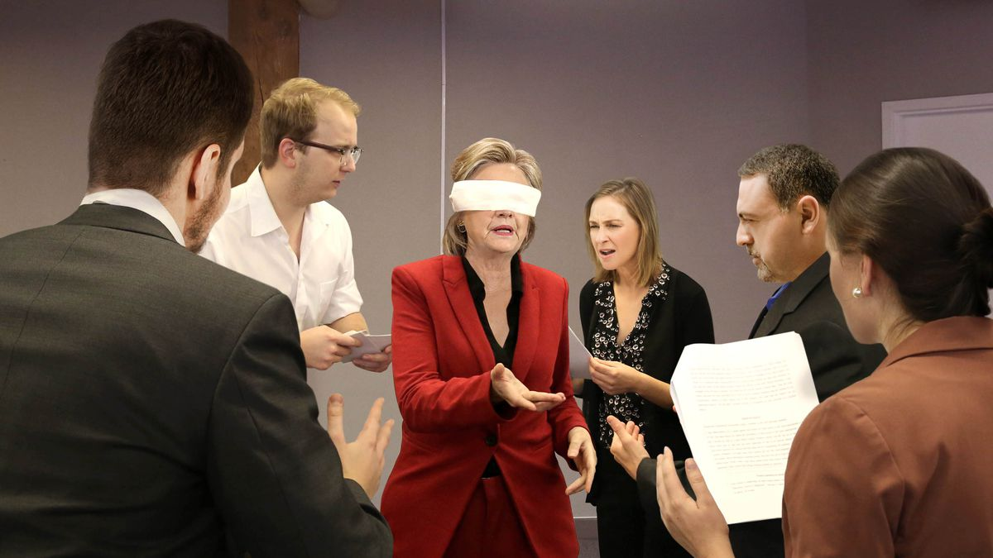
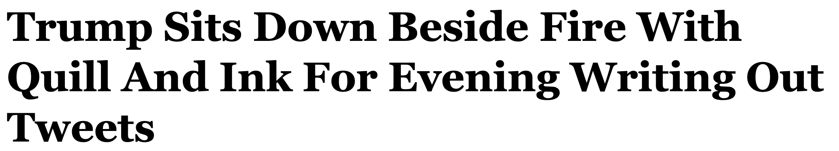
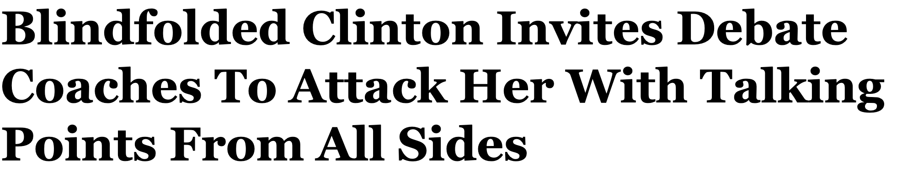
Example: Satire or parody
Source: The onion (Trump; Clinton)

Slide 7
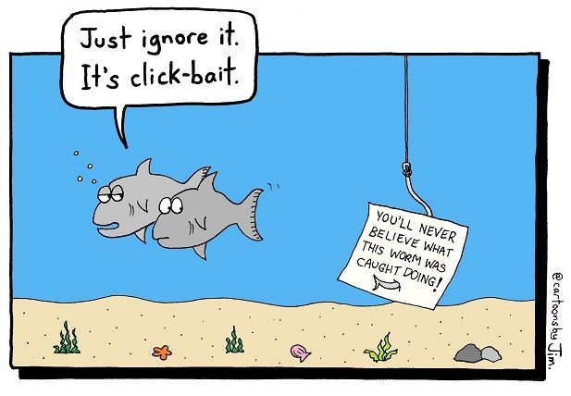
Examples: False connection

Slide 8
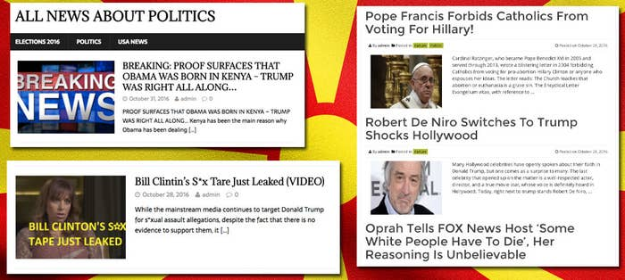
Examples: False connection
Clickbaity titles:
10 Reasons Why Noise Cancelling Headphones Are the Best
10 Things You Need to Do Before Buying a House
Piggybacking: “Forbes Entrepreneur Shares X Tips…”
This Is Why Business Owners are Investing in Bitcoin
“This Is The Surprising Way Coronavirus Has Changed Travel Insurance”‘
“This is how business owners are saving thousands on their taxes”
“You Can Now Save Money with Y New Strategy”
“The Last Flatiron You Will Ever Need”
‘“166 Photos You Won’t Believe Are Not Photoshopped”
“Why You Should Invest in NFT Now”
‘SPREAD THIS: THE ELECTION POLLS ARE RIGGED …’
……
Source: BuzzFeed news

Slide 9
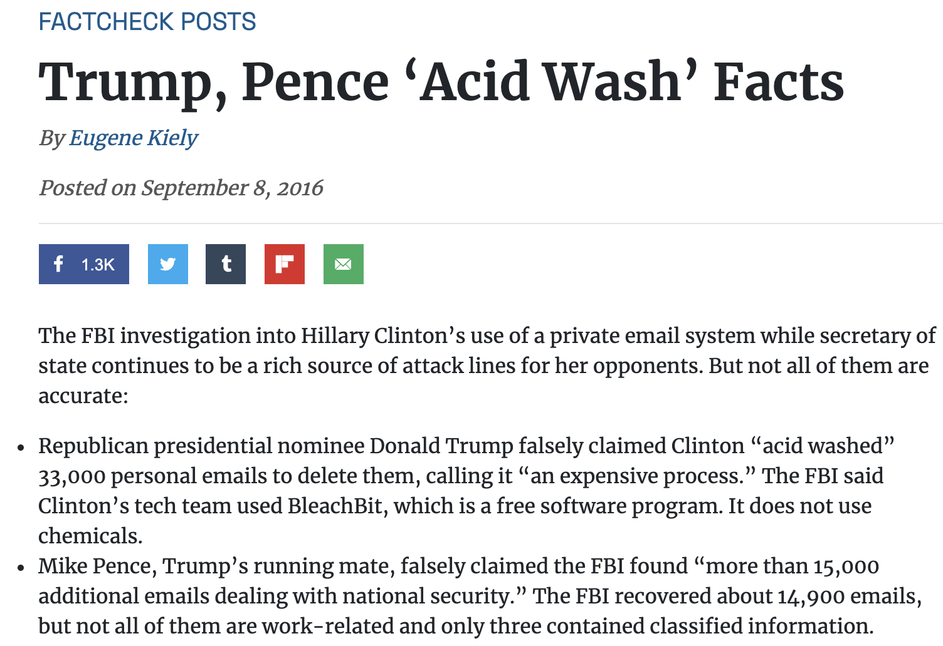
Examples: Misleading content

Slide 10
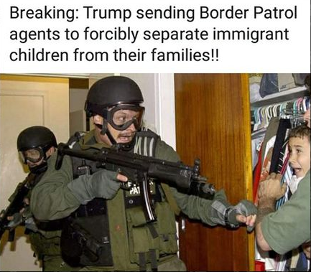
Example: False content
Google reverse image search
TinEye

Slide 11
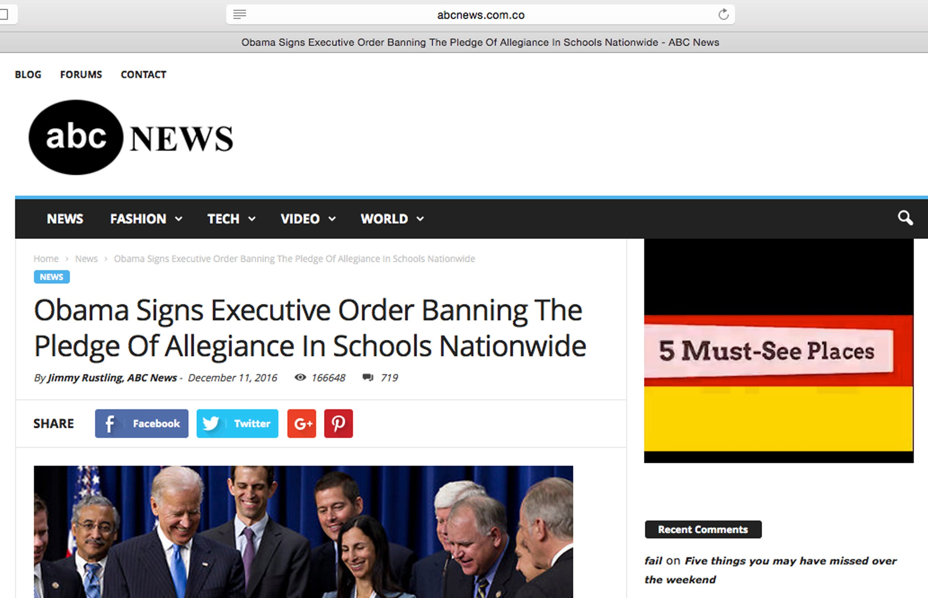
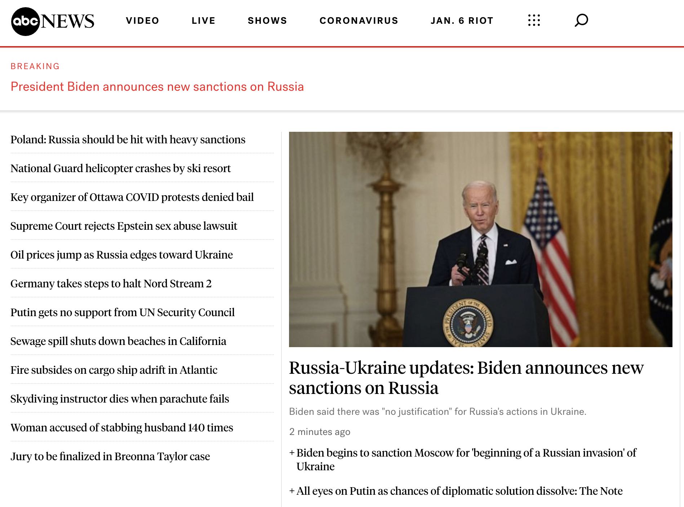
Examples: Imposter content
abcnews.com.co
abcnews.com

Slide 12
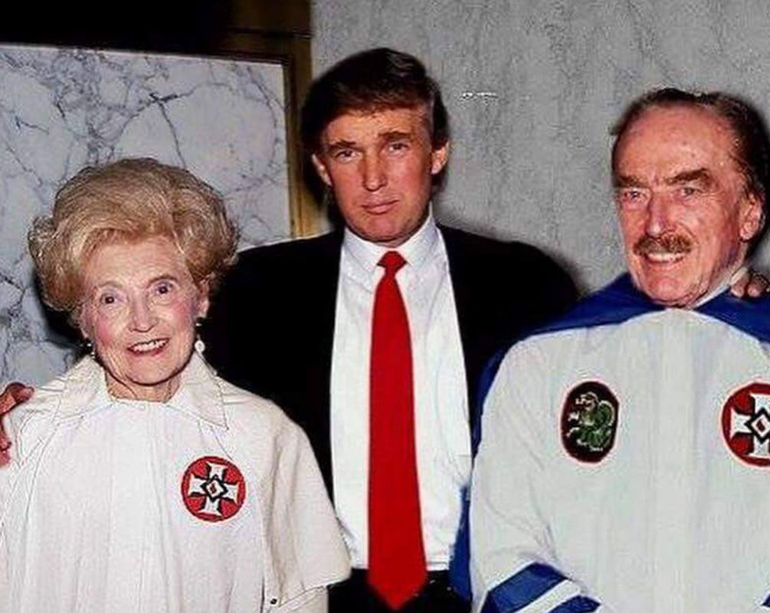
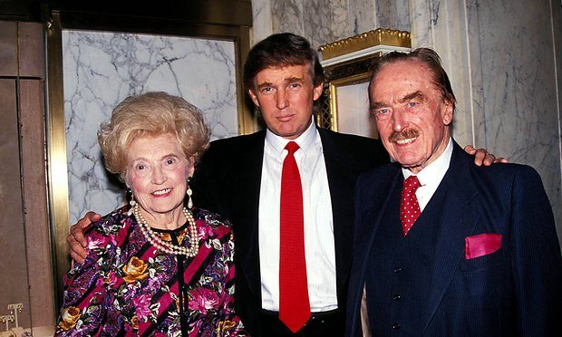
Examples: Manipulated context
Source: Snopes

Slide 13
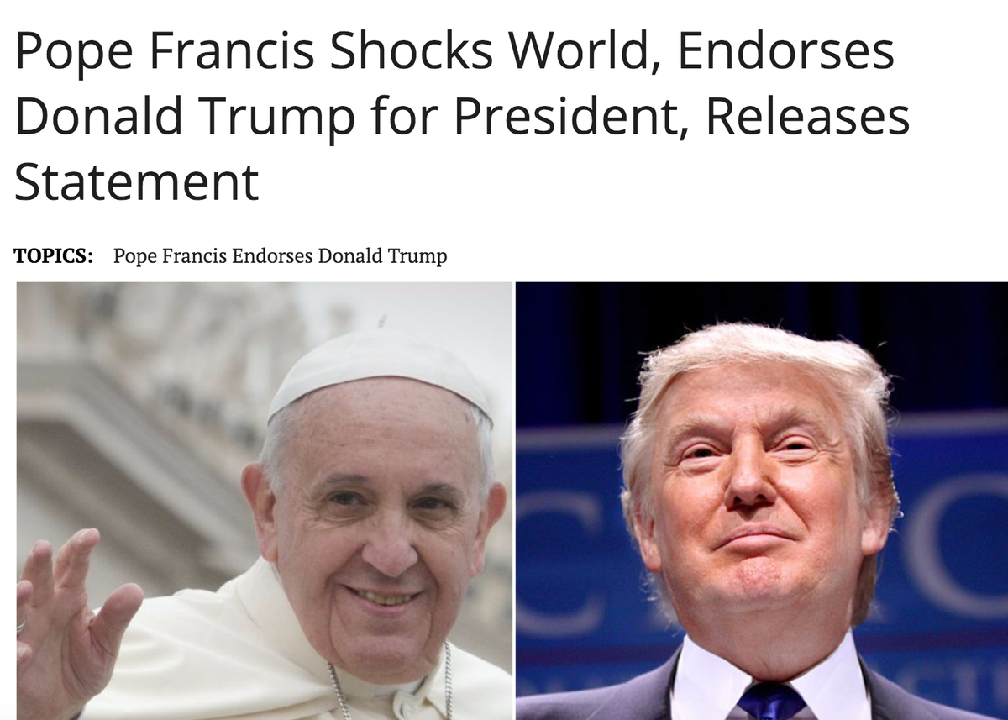
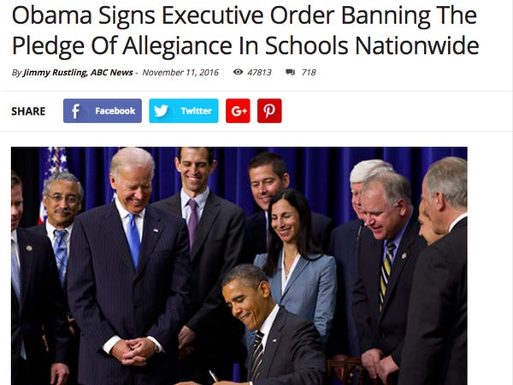
Examples: Fabricated content

Slide 14
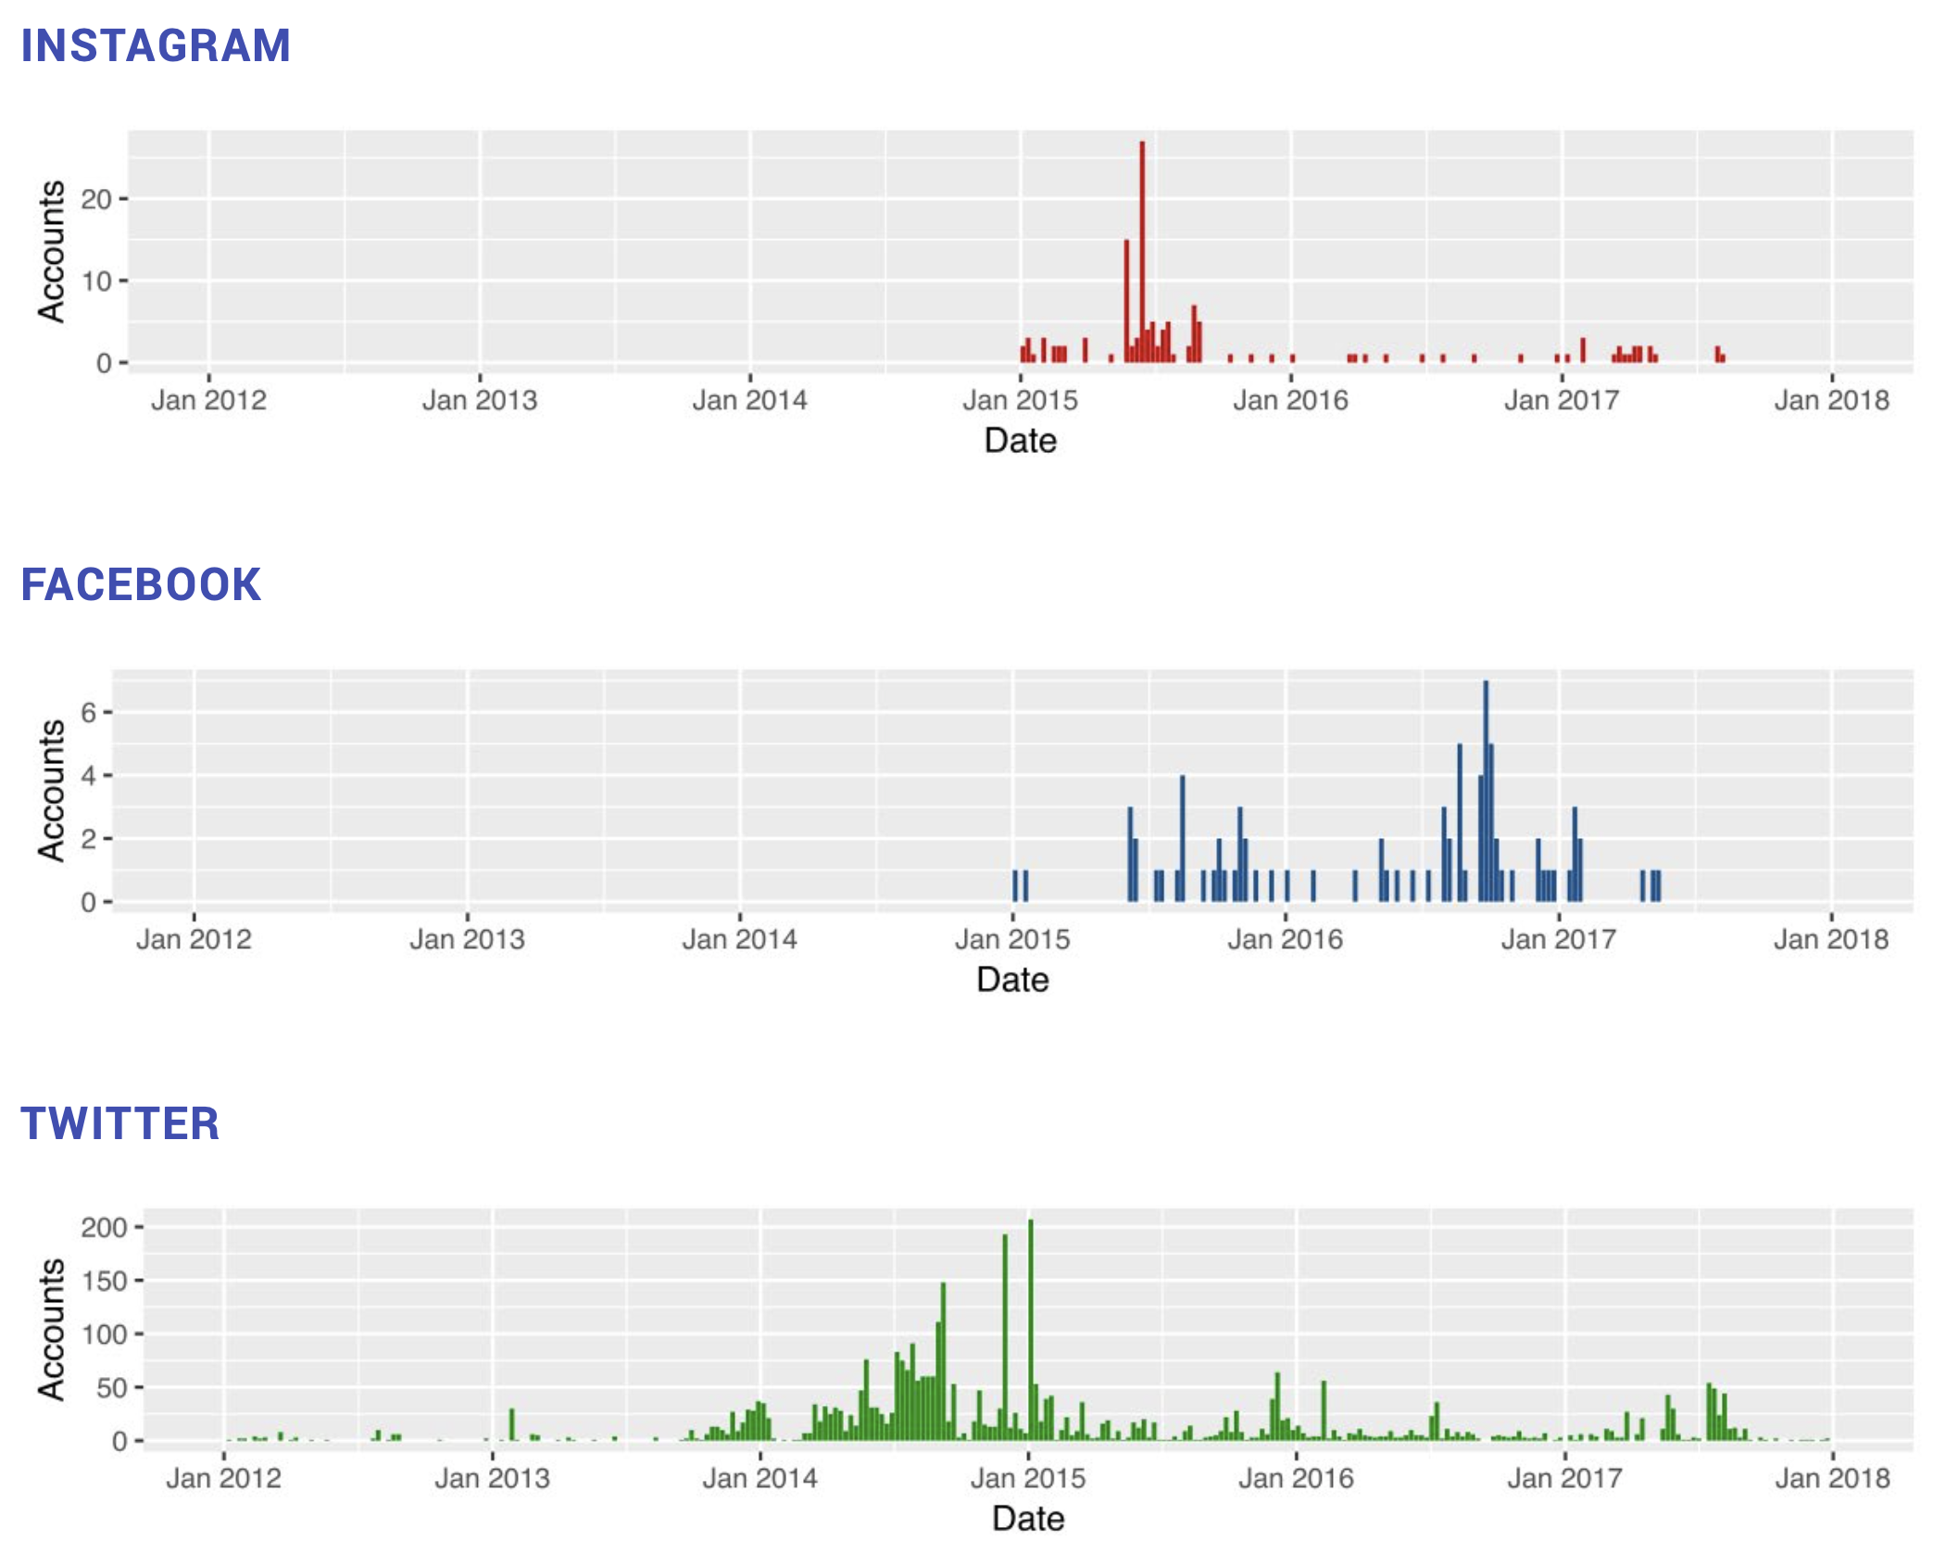
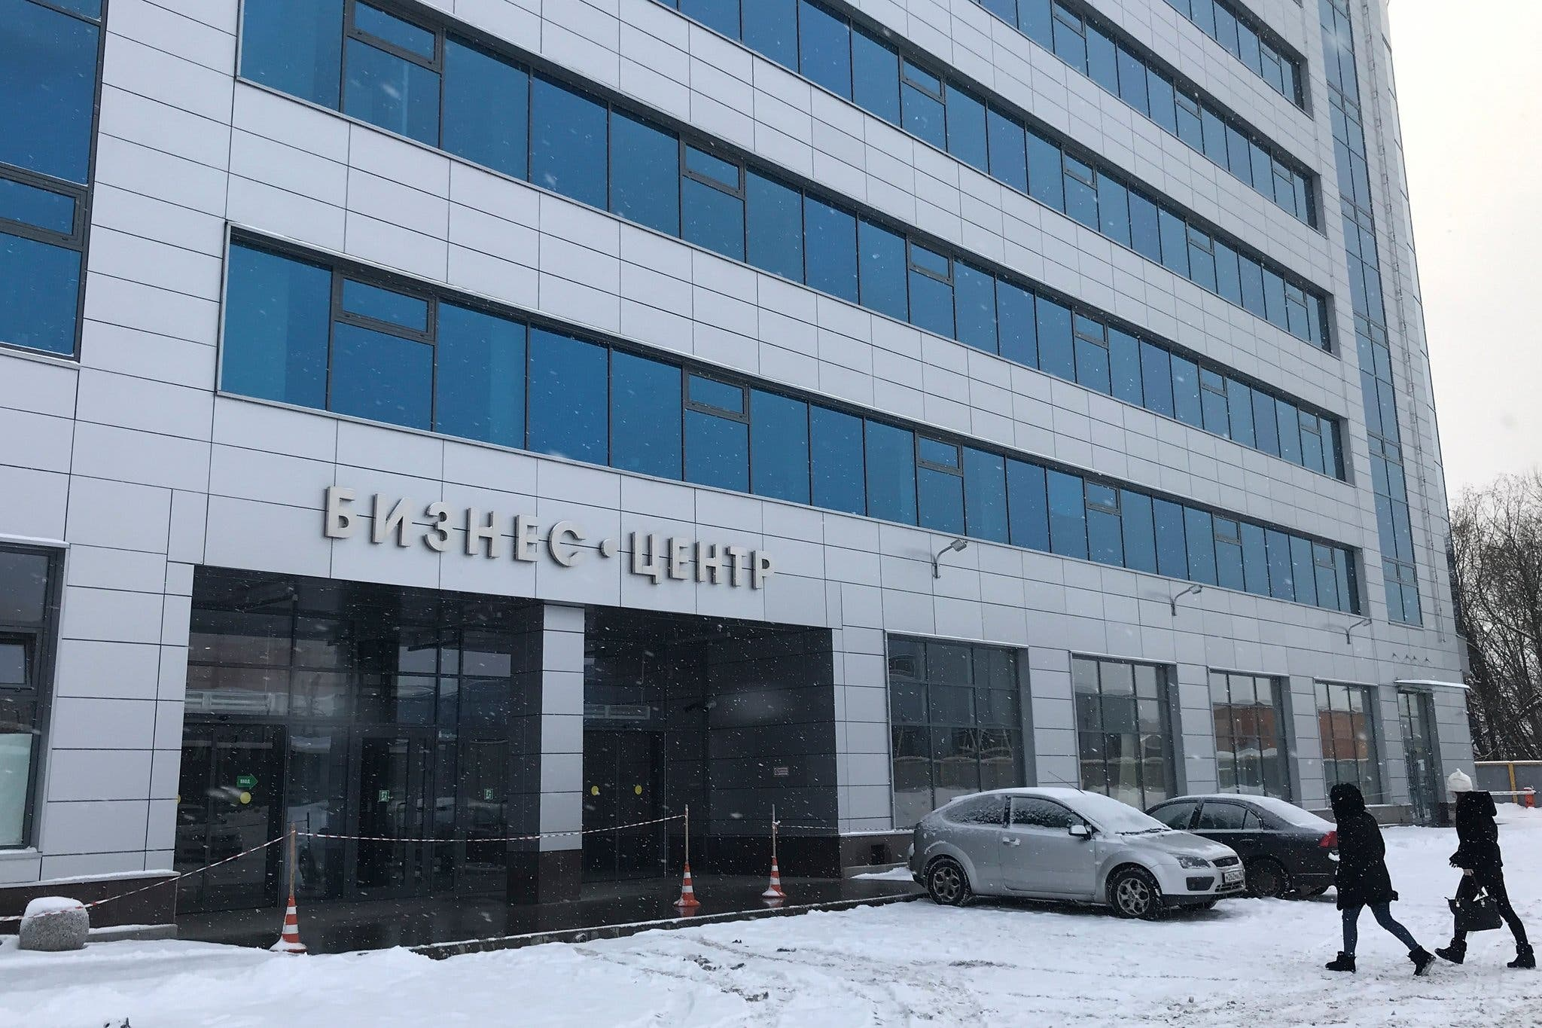
Examples of disinformation (information warfare)
Source: DiResta et al. (2019)
Notes:
It is now well established that the IRA operated thousands of Twitter accounts posing as Americans to weigh in on U.S. political discussions on social media between 2014 and 2017. Special Counsel Robert Mueller’s indictment of the IRA noted that the campaign’s goal was to “[spread] distrust towards the candidates and the political system in general” (U.S. v. Internet Research Agency LLC). Since then, considerable scholarly work has explored the reach and performance of IRA con- tent online. But social media discourse does not operate in a vacuum. In several instances, IRA-produced content moved from social media into the U.S. news envi- ronment where it undoubtedly enjoyed larger reach, demonstrating susceptibilities of the press, which has long been a target of foreign intelligence operations

Slide 15
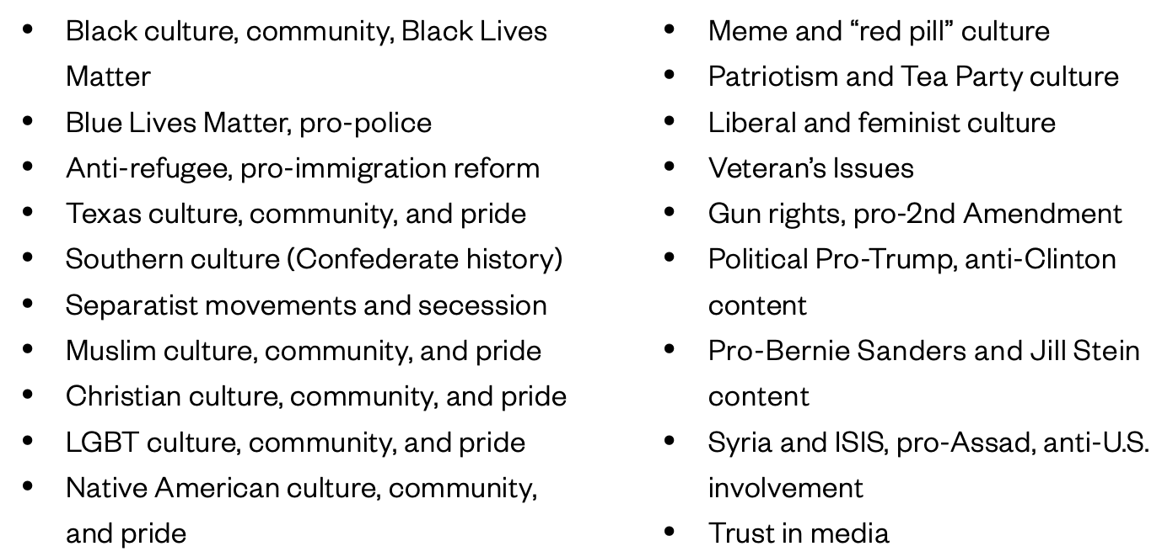
Examples of disinformation (information warfare)
Source: DiResta et al. (2019)
Notes:
It is now well established that the IRA operated thousands of Twitter accounts posing as Americans to weigh in on U.S. political discussions on social media between 2014 and 2017. Special Counsel Robert Mueller’s indictment of the IRA noted that the campaign’s goal was to “[spread] distrust towards the candidates and the political system in general” (U.S. v. Internet Research Agency LLC). Since then, considerable scholarly work has explored the reach and performance of IRA con- tent online. But social media discourse does not operate in a vacuum. In several instances, IRA-produced content moved from social media into the U.S. news envi- ronment where it undoubtedly enjoyed larger reach, demonstrating susceptibilities of the press, which has long been a target of foreign intelligence operations

Slide 16
Fact-checking in the social media
Platform | Policies
Facebook | Facebook identifies misinformation after it goes viral and refers it to third party fact-checkers before applying a label. Punishments are threatened for repeat offenders.
Twitter | No comprehensive misinformation policies exist. Twitter will label or remove manipulated media, or anything intended to misinform or interfere with elections or other civic processes. Exceptions are made for key elected officials.
YouTube | YouTube provides information from third-party fact-checkers on specific searches. Specific videos are not fact-checked.
Pinterest | Pinterest says they will remove content from conspiracy theories, medical misinformation, election misinformation, and disinformation campaigns. Manipulated media will also be removed. The fact-checking process is not outlined.

Slide 17
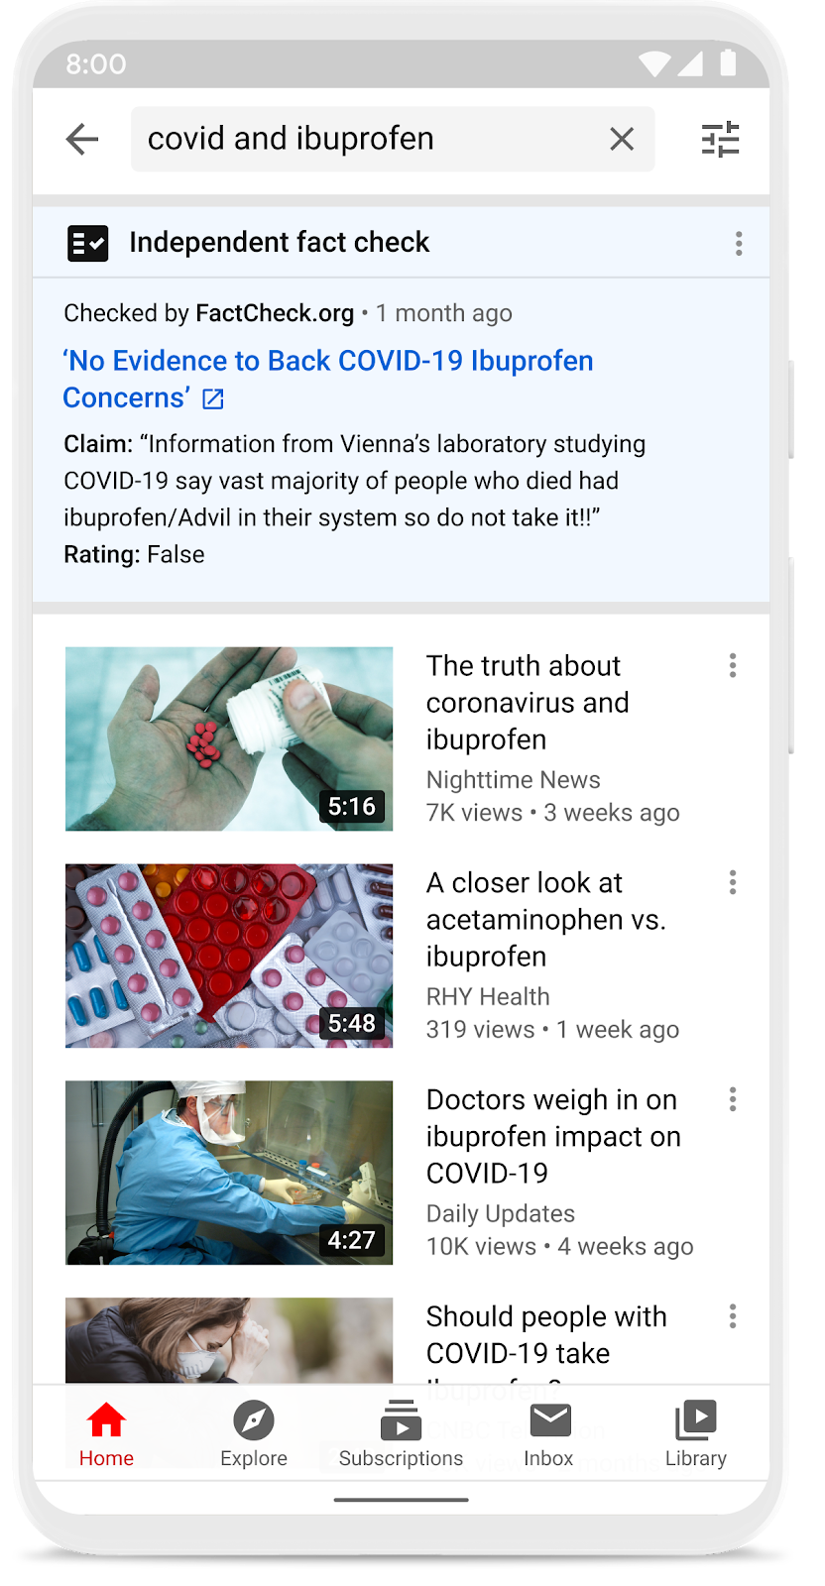
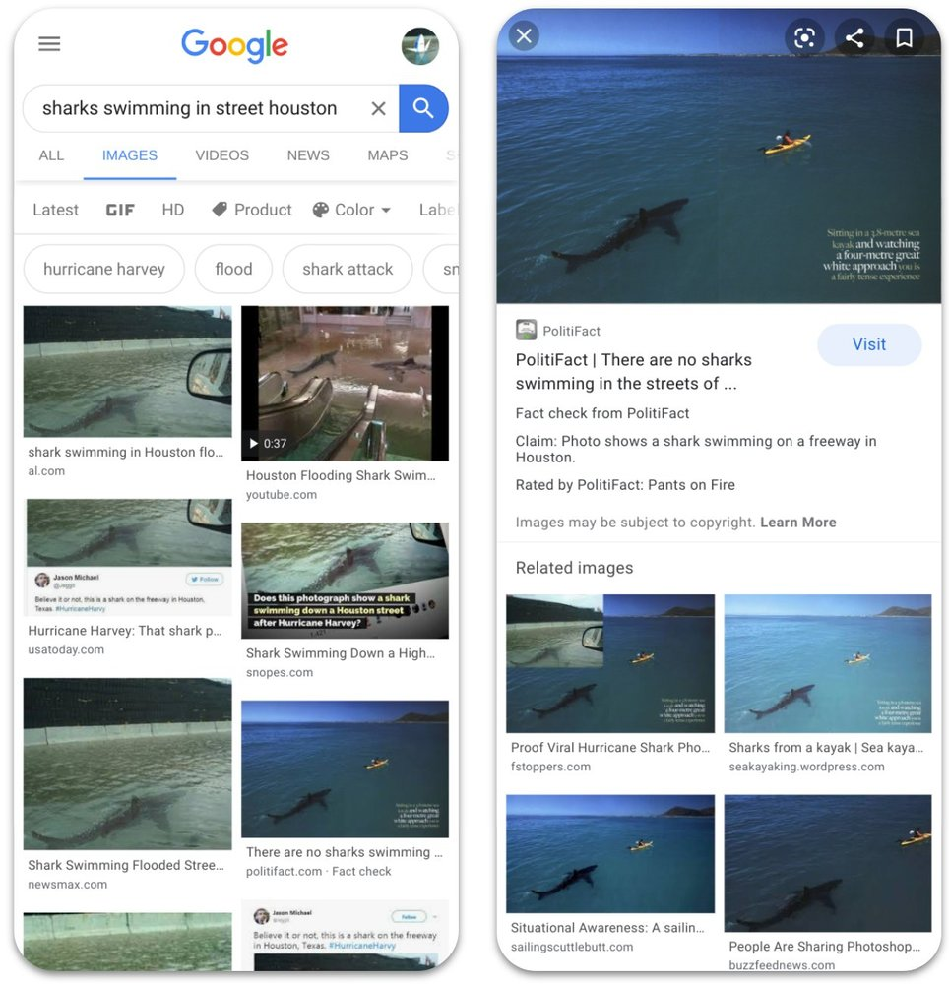
Fact-checking in the social media

Slide 18
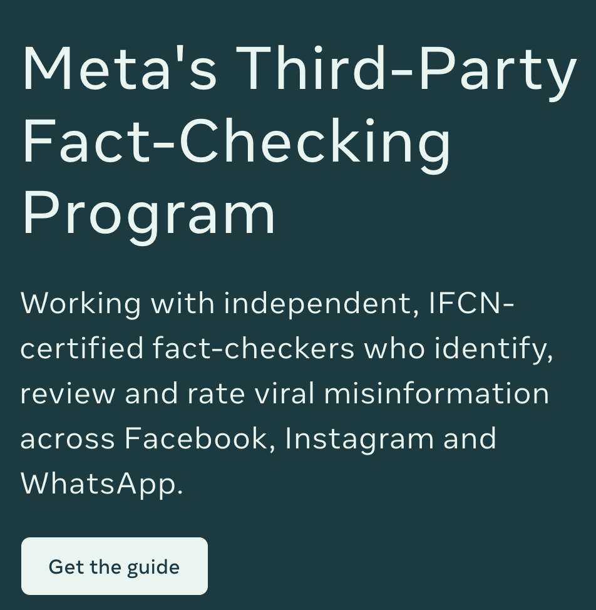
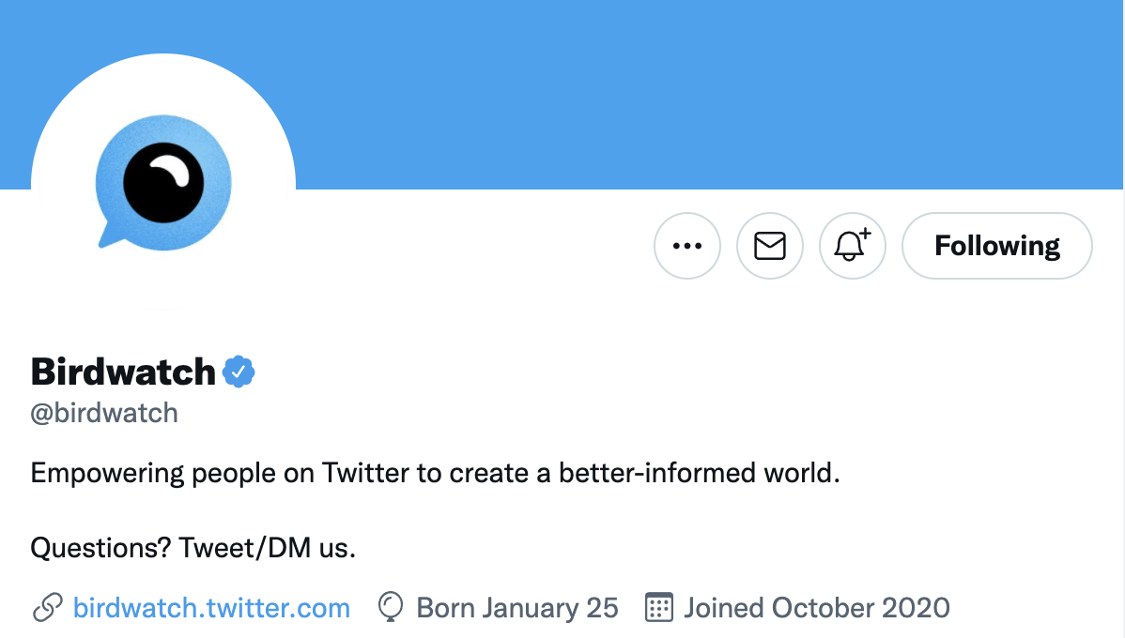
Fact-checking in the social media

Slide 19
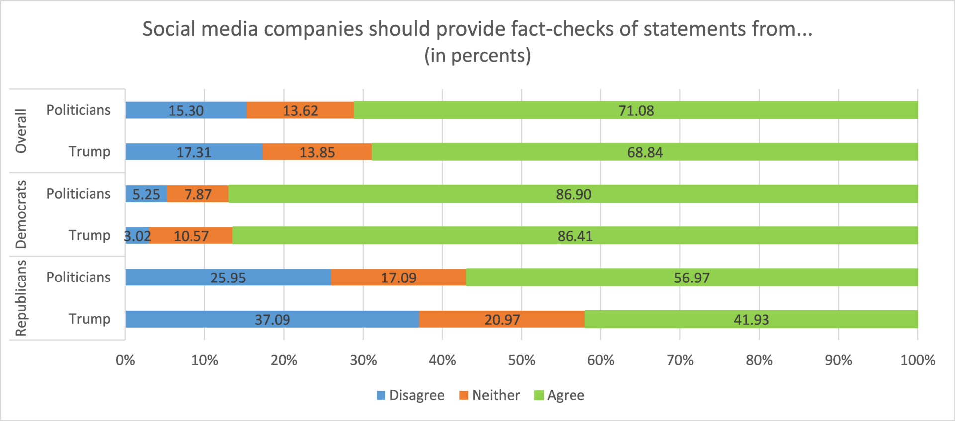
Support for fact-checking? (Rich et al., 2020)
Notes:
The results show Democrats as more supportive of fact-checks overall than Republicans. More interesting is that Republican support for fact-checking Trump dropped by 15 percentage points in comparison to fact-checking politicians in general, with a difference in means test statistically significant at the .01 level. One potential reason for the decline in support is that Republicans may interpret the prompt as unfairly singling out Trump, while supporting fact-checks of politicians of politicians that they do not like.

Slide 20
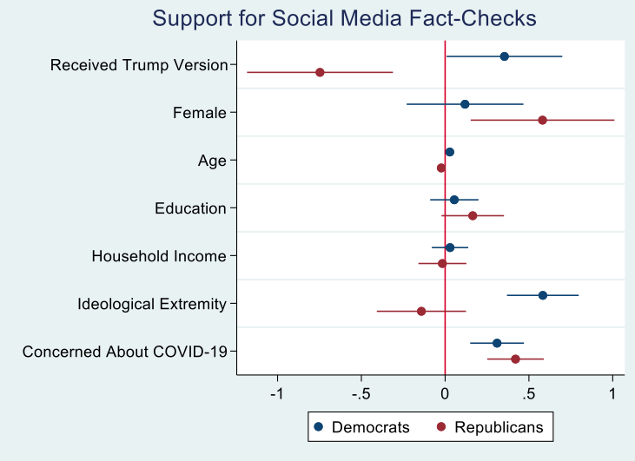
Support for fact-checking? (Rich et al., 2020)
Notes:
The effects of the framing of fact-checks and concern about contracting COVID-19 remain after considering demographic factors and ideological extremity.
Version 1: Social media companies should provide fact checks of statements from politicians.
Version 2: Social media companies should provide fact checks of statements from President Trump.
We find that majorities supported fact-checking with clear differences among Democrats and Republicans. Democratic support shows marginal differences between fact-checks of politicians versus President Trump. A majority of Republicans support fact-checks of politicians but not of Trump.
Concern about contracting COVID-19 corresponds with support for fact-checks with a larger effect among Republicans.
Fact-checking interventions work only for those people who see value in fact-checking.

Slide 21
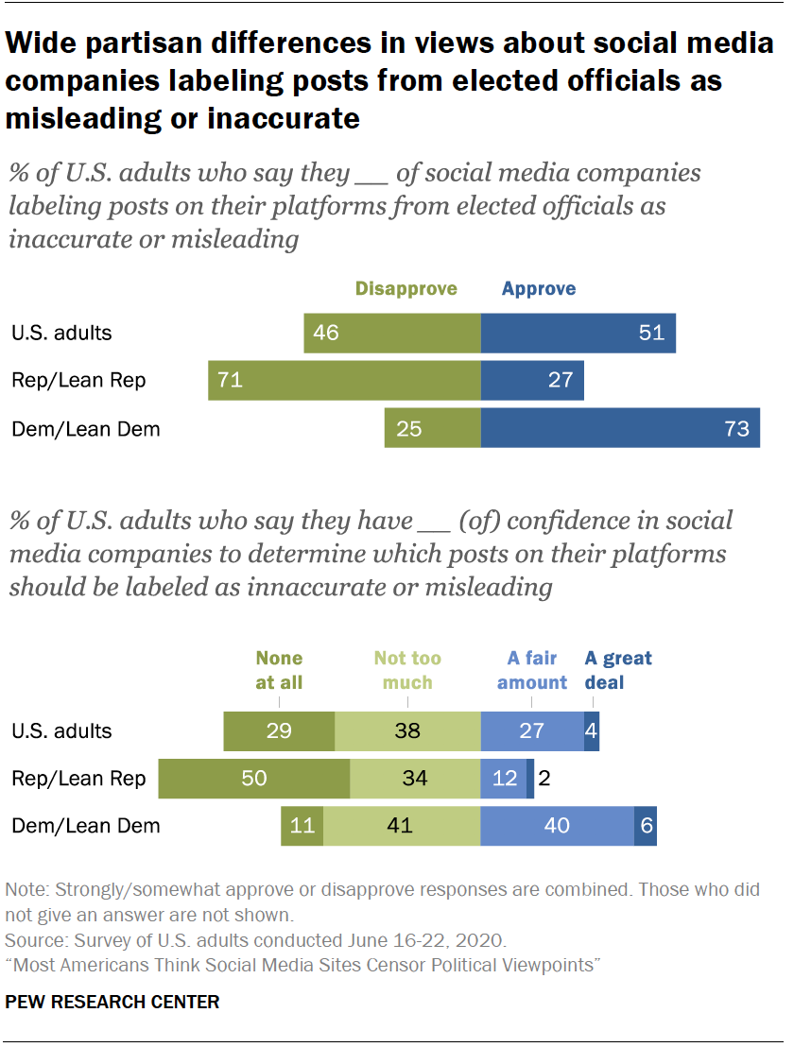
The partisan differences toward fact-checking? (Vogels et al., 2020)

Slide 22
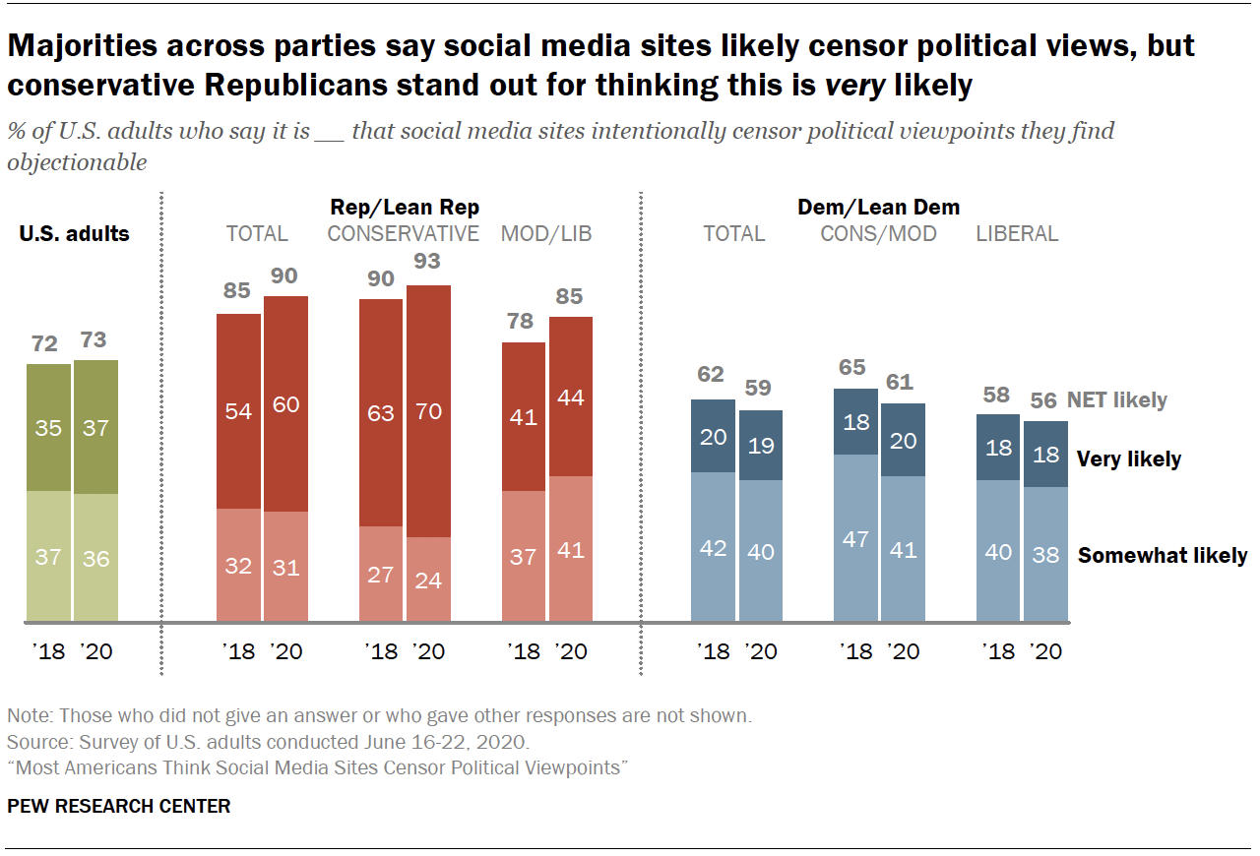
The partisan differences toward fact-checking? (Vogels et al., 2020)

Slide 23
Fact-checking as gatekeeper (Dr. Brian Weeks)
Be skeptical!
Too good to be true!
If it elicits either extreme (positive or negative) emotions
Read beyond the headline; Who created the story and why?
The author
The organization
The data it was published
The evidence
Are other sources covering it?
What’s missing?
Be aware of your (implicit) bias
Make good use of the fact-checking website: Snopes, Factcheck.org, Politifact, and etc.

Slide 24
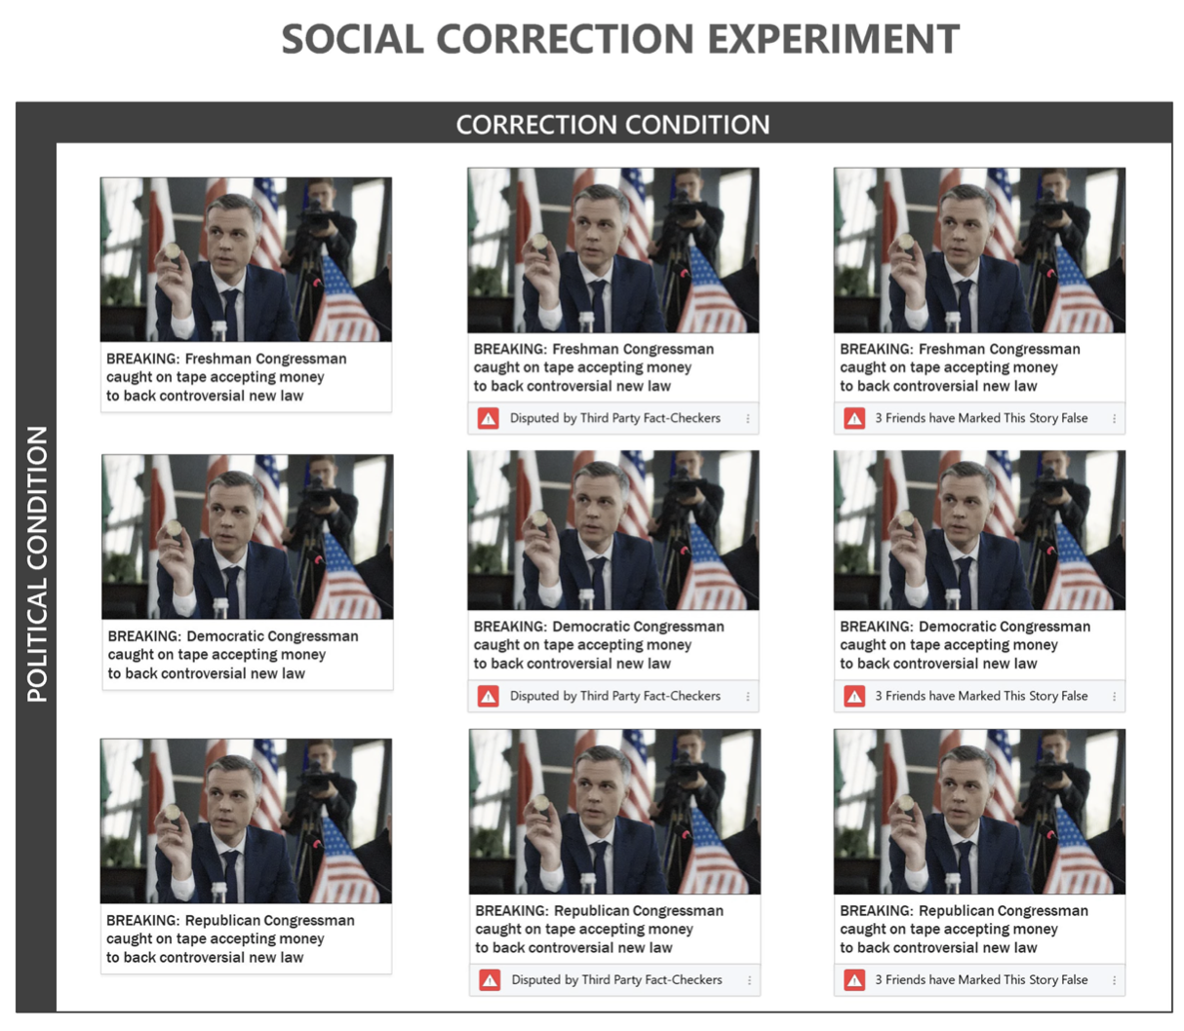
Fact-checking as gatekeeper (Ognyanova, 2021)

Slide 25
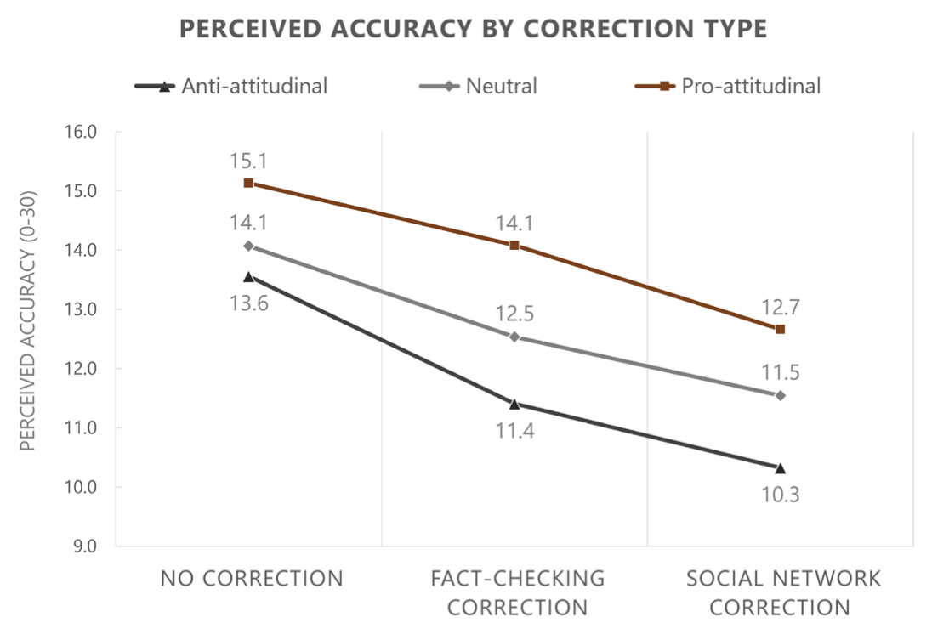
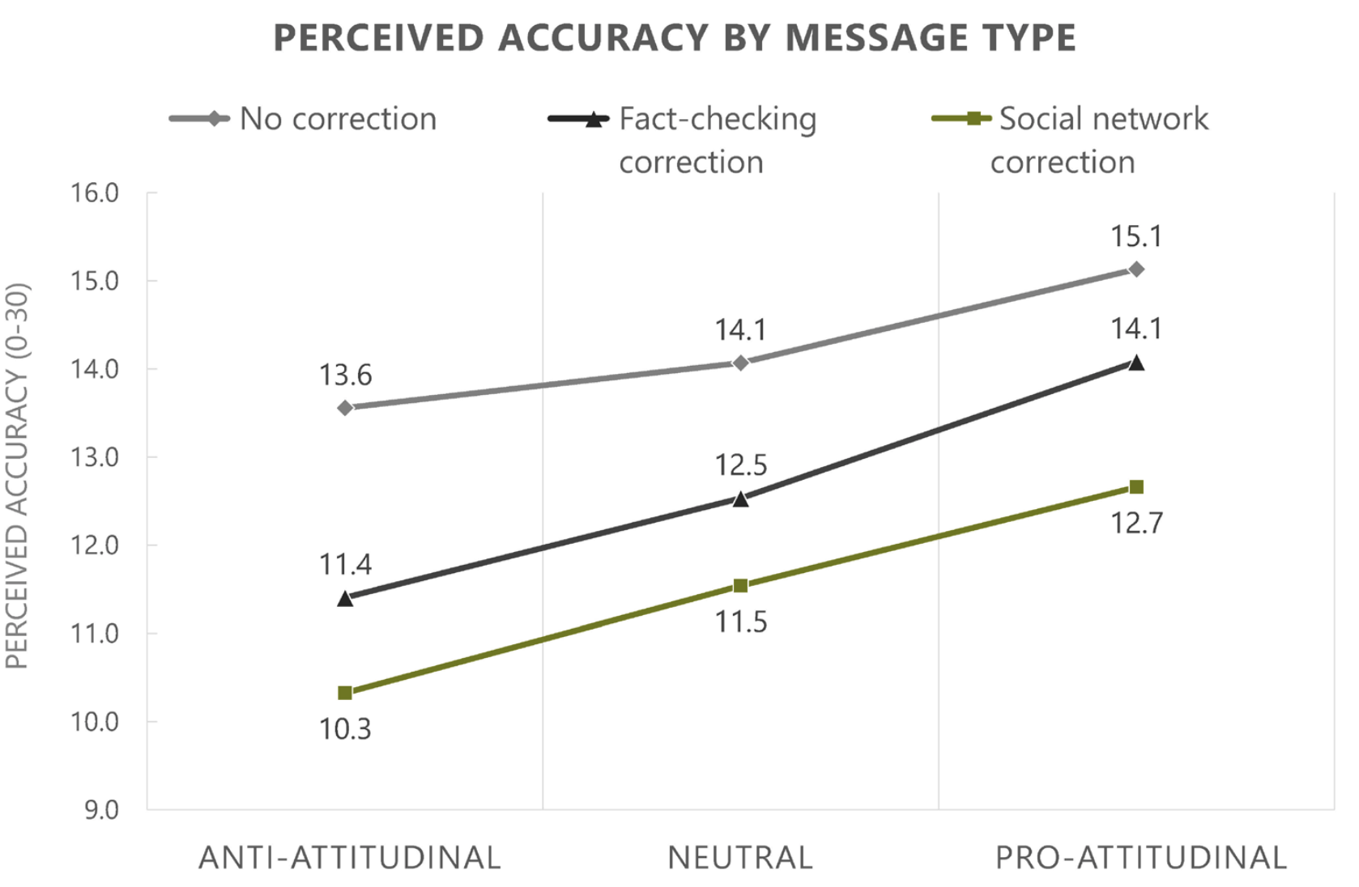
Fact-checking as gatekeeper (Ognyanova, 2021)

Slide 26
Reference
Ognyanova, K. (2021). Network approaches to misinformation evaluation and correction. In Weber M. S., & I. Yanovitzky (eds). Networks, knowledge brokers, and the public policymaking process (pp. 351-373). Palgrave Macmillan.
Rich, T. S., Milden, I., & Wagner, M. T. (2020). Research note: Does the public support fact-checking social media? It depends who and how you ask. The Harvard Kennedy School Misinformation Review. 1(8). https://misinforeview.hks.harvard.edu/article/research-note-does-the-public-support-fact-checking-social-media-it-depends-who-and-how-you-ask/
Vogels, E. A., Perrin, A., & Anderson, M. (Nov 12th, 2020). Most Americans think social media sites censor political viewpoints. Pew Research Center. https://www.pewresearch.org/internet/2020/08/19/most-americans-think-social-media-sites-censor-political-viewpoints/
Wardle, C. (Feb 16, 2017). Fake news. It's complicated. First Draft. https://medium.com/1st-draft/fake-news-its-complicated-d0f773766c79
Wardle, C., & Derakhshan, H. (2017). Information disorder: Toward an interdisciplinary framework for research and policymaking. Council of Europe report. https://rm.coe.int/information-disorder-report-november-2017/1680764666
Zimdars, M., & McLeod, K. (Eds.). (2020). Fake news: understanding media and misinformation in the digital age. MIT Press.

